Slide 1
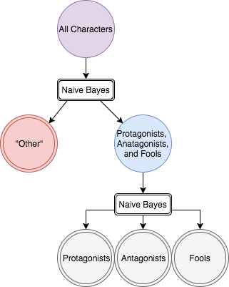
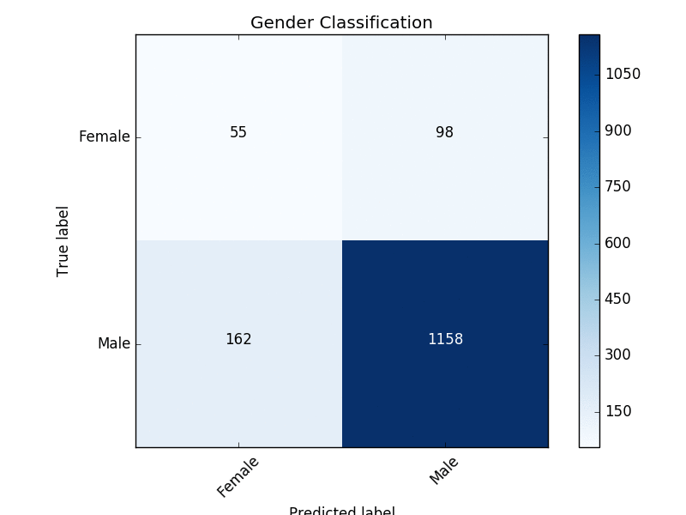
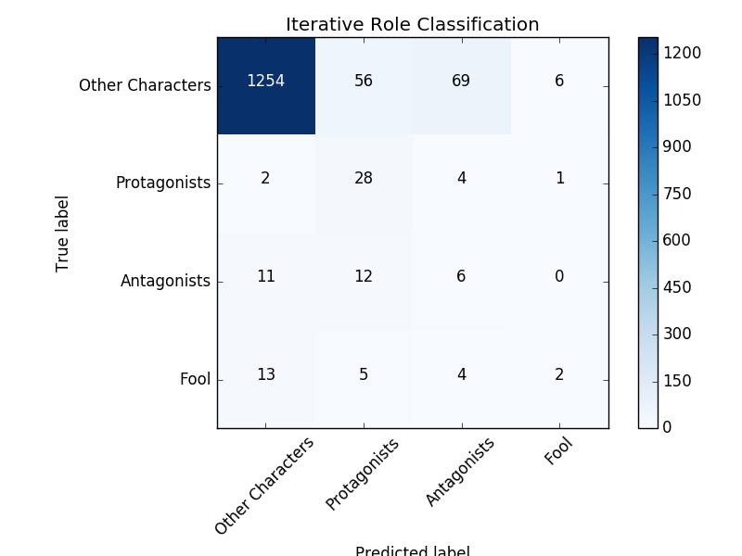
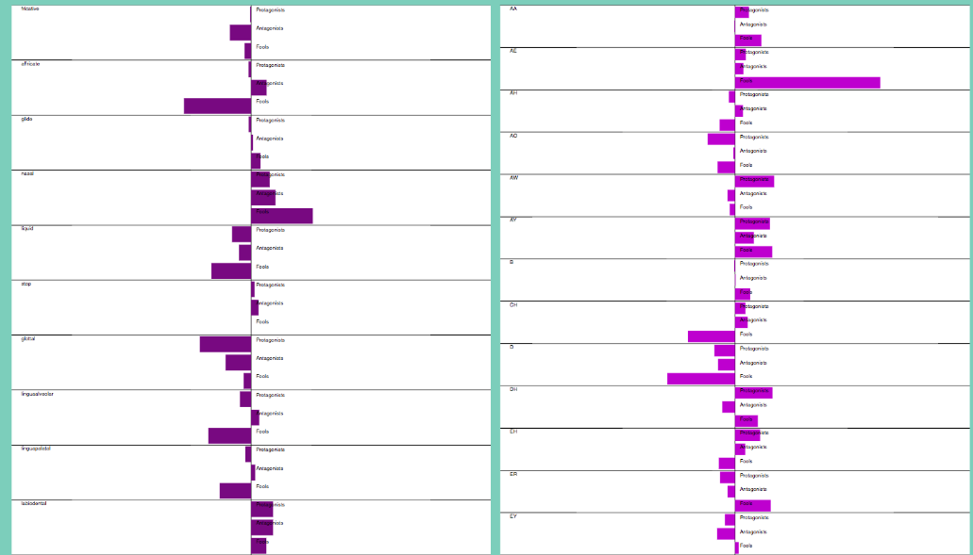
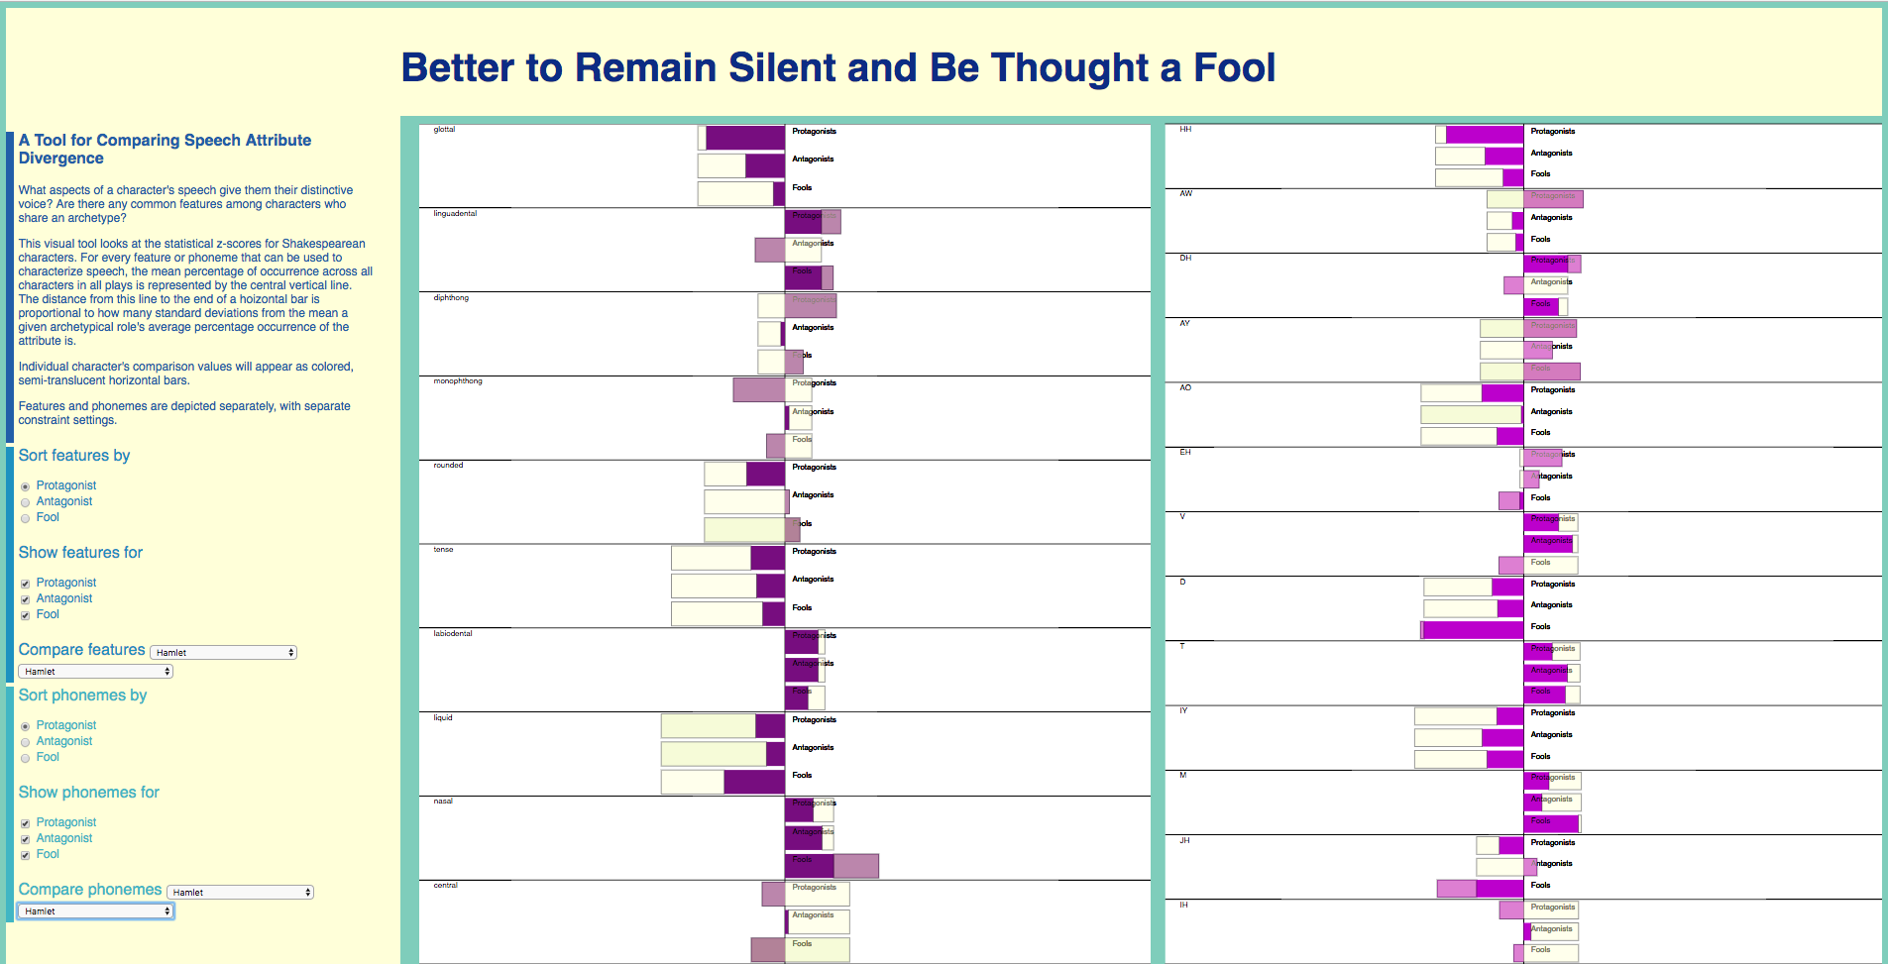
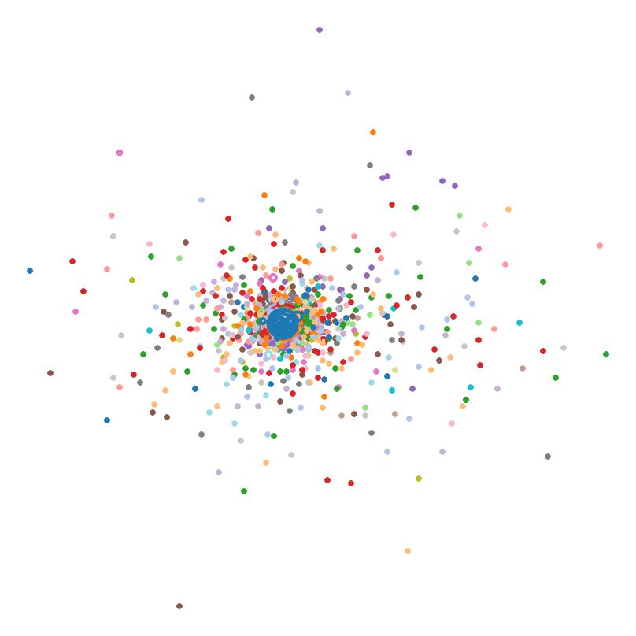
Sonic Signatures: Do Shakespeare’s Characters Have Distinct Speech Qualities?
Estelle Bayer, Liz Nichols, Eric Alexander
Computer Science, Carleton College
Why Sonic Signatures?
Naïve Bayes Classification
The sounds that make up a word are thought to have meaning. When researchers make up gibberish words for objects, people tend to agree on which gibberish words should refer to small and large objects. When close reading a poem, readers pay attention to assonance and consonance and draw meaning from the repetition of sounds. | Is it then possible to visualize how a character “sounds”? | Do female characters have a different sound pattern than male characters? Do protagonists sound different from antagonists? Do characters that share aspects of their characterization have a similar “sonic thumbprint”? | Are characters differentiable from one another based on how they sound?
Having extracted phoneme and feature data, we wanted to see if simple classifiers could use these data to differentiate between different types of characters.
Highest success was achieved when training data was weighted by number of speaking lines, and role determination was done iteratively.
The iterative Bayes classification was performed through first filtering out any character classified as “other” before re-classifying the remaining characters as antagonists, protagonists, or fools.
Quantifying “How Characters Sound”
In any language, words break down into a set of fundamental elements called phonemes | The features of a phoneme describe the physical processes used to produce it | We analyzed characters for both the types of sounds they tended to make, and the specific sounds they made
The iterative naïve Bayes process yields more useful results in highly unbalanced data sets
Confusion matrix resulting from weighted naïve Bayes classification of gender
Confusion matrix resulting from weighted iterative naïve Bayes classification of role
Z-Score Comparisons
Do certain speech attributes occur with higher frequency than average among specific archetypes?
Once we established standards for specific roles, we wanted a way to visually compare the deviation from norm for any given character to those norms.
The interactive z-score visualization allows users to sort features and phonemes by descending order of significance for a role; view only certain roles; and view the distance between a character’s z-scores and the averages for a role.
Depicting Features Information (MDS)
An incomplete view of the basic view of z-score data for phoneme and features of archetypical roles, without any comparisons
We turned each character’s speech into a vector and used multidimensional scaling to look for groups of characters.
A partial view of the comparison between Hamlet’s Hamlet and the standards for all archetypes
“Ophelia’s Oh”
Stanley Newman, in his experiments in Sound Symbolism, scaled vowels from bright to dark in how subjects perceived them. “IH” as in “Lit” sounded brightest, while “UH ” as in “Put” sounded darkest and biggest.
We wanted to examine which characters, if any, tended toward bright or dark vowels, so bars below the line represent below average usage of a vowel, while bars above the line represent above average usage of a vowel. Brightly colored bars represent brightly scaled vowels, while dark bars are dark vowels.
A multi-dimensional scaling, color-coded by play and with number of lines encoded as size of bubble.
References
What Next?
Thank You
Scikit-learn: Machine Learning in Python, Pedregosa et al., JMLR 12, pp. 2825-2830, 2011.
Olson M. Determining the gender of Shakespeare’s characters. Stanford University[Internet]. 2013.
Bird, Steven, Edward Loper and Ewan Klein (2009), Natural Language Processing with Python. O’Reilly Media Inc.
Folger Shakespeare Library. (n.d.) Shakespeare's Plays, Sonnets and Poems from Folger Digital Texts. Retrieved from www.folgerdigitaltexts.org
Expanding analysis beyond Shakespeare
Implementing in-place comparison of user-provided texts
Creating visualizations for characters’ sonic signatures
Work with domain material experts to assess usefulness as tools of discovery.
Eric Alexander
Mike Tie et al
Carleton College

